Slide 1
Advanticsys
Weekly update – 24/03/2023
Topics to discuss:
Approval of detection process
Proposal on final product/summary
Discussion to understand data

Slide 2
Abnormal detection process
Compare production in each inverter – check performance vs Average
Abnormal(>5%)
Check performance vs expectation based on UV/Temp
Abnormal(>5%)
Check performance vs past energy generation (identify patterns over time)
Within expectation
Normal
Within average
Normal
Off track
List as abnormal
Follow the pattern
Normal
Step 1
Assumptions:
Data available is on an inverter basis
Solar panels with same specifications relate to each inverter. (By this we mean the configuration of each inverter is identical)
The tolerance for considering abnormality is set to 5%. (Please advise us if this is not acceptable)
Solar panels at the start are non faulty ones.
Step 2
Step 3

Slide 3
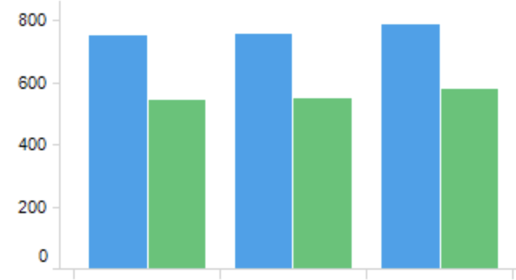
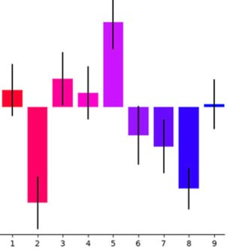
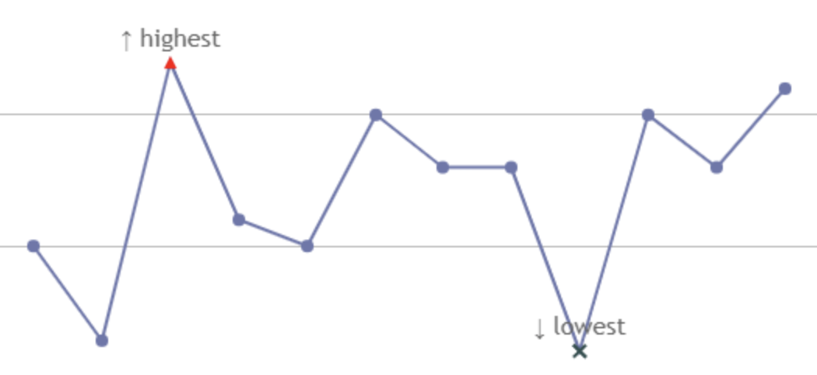
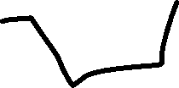
No prediction in step 1, just visual summary for actual/live data
Step 1a – show actual number, highlight inverter with less power
Daily/Minute
22/03/2023
100kwh
80kwh
100kwh
95kwh
100kwh
100kwh
110kwh
105kwh
100kwh
100kwh
Step 1b – show irradiation/temp for each inverter, highlight inverter overheat ….
Inverter 1 performance
Step 3 – predict performance overtime, compare with actual power generation
Irradiation/Temp By Inverter
Act v Prediction by inverter
01/01/2023 – 01/03/2023
Step 2 – predict power generation performance based on actual (live)irradiation/temp and other factors
Abnormal Inverters require investigation
No. | Act | Average | Var % | Pred | Var % | Capacity | Var % | result
Inv 1 | 100kwh | 100kwh | 0 | 100kwh | 0 | 95kwh | < 5% | normal
Inv 2 | 80kwh | 100kwh | 20% | 100kwh | 20% | 90kwh | 10% | abnormal
Final step – conclusion

Slide 4
Questions
Compare irradiance/temp vs energy generated
Inside or outside?
Compare production in each inverter
Which number to use

Slide 5
Questions in Dataset
Which energy number in dataset to monitor
Act_Power - kw
Today_energy – kwh
Status per inverter meaning
Temp and irradiance from 2 weather monitoring stations
Are they inverter temp or outside temp?

Slide 6
